Slide 1

Geographic Information Systems - GIS
Jessica Griffin

Slide 2

Intro to GIS
Geography is the science of our world
Using GIS helps us understand the Earth and apply geographic knowledge to a variety of problems.

Slide 3
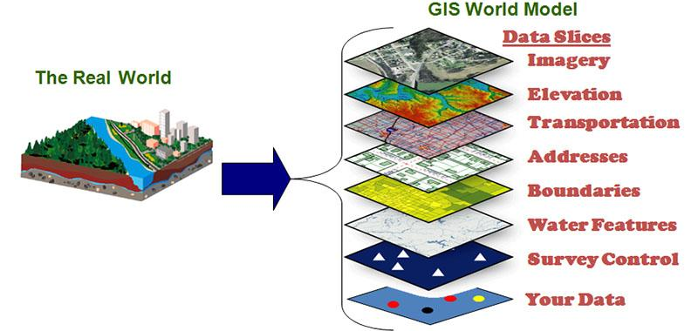
Intro to GIS
Geographic information system = GIS
An information technology system that uses geographic information or “geospatial data”
You can store, manipulate, analyze and display information
With GIS you can stack multiple layers of geographic data to provide an easy means to present and interpret it

Slide 4
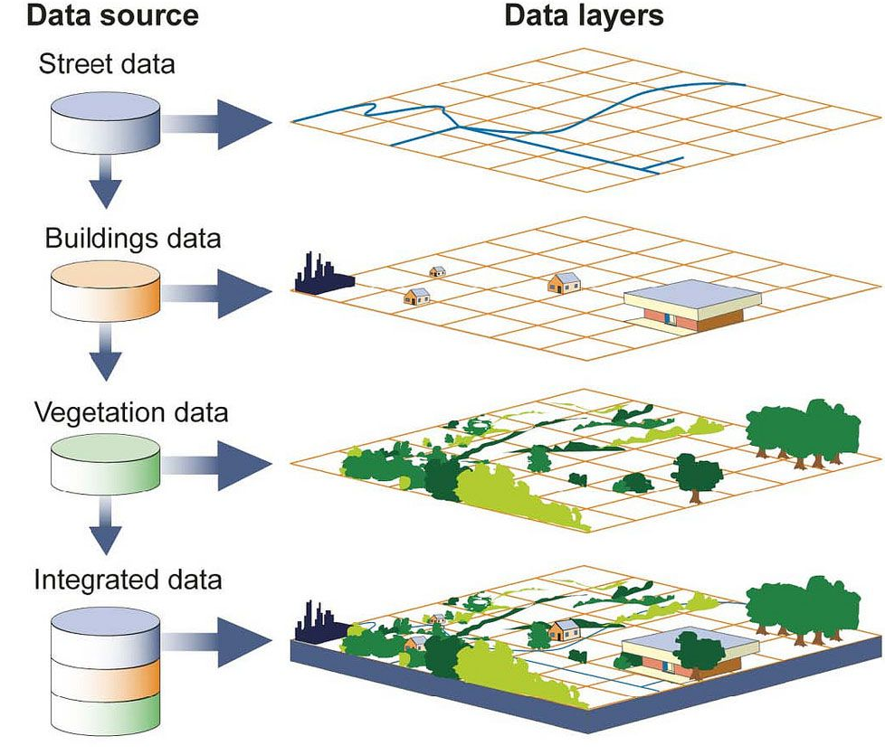
Intro to GIS
GIS can show many different kinds of data on one map, such as
  Streets
  Buildings
  Vegetation
  Rivers
This enables people to see, analyze and understand patterns and relationships in the landscape

Slide 5
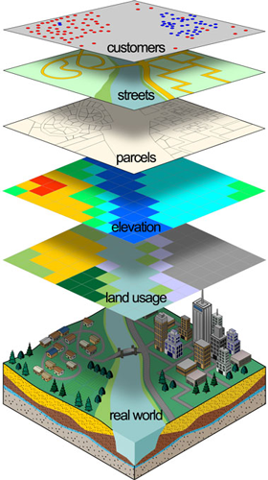
Intro to GIS
GIS is becoming an increasingly important tool for
  Environmental Management
  Business
  Government
  Emergency Response
  Military
  Tourism
If you use a computer or a cell phone, you have probably already used a GIS.

Slide 6
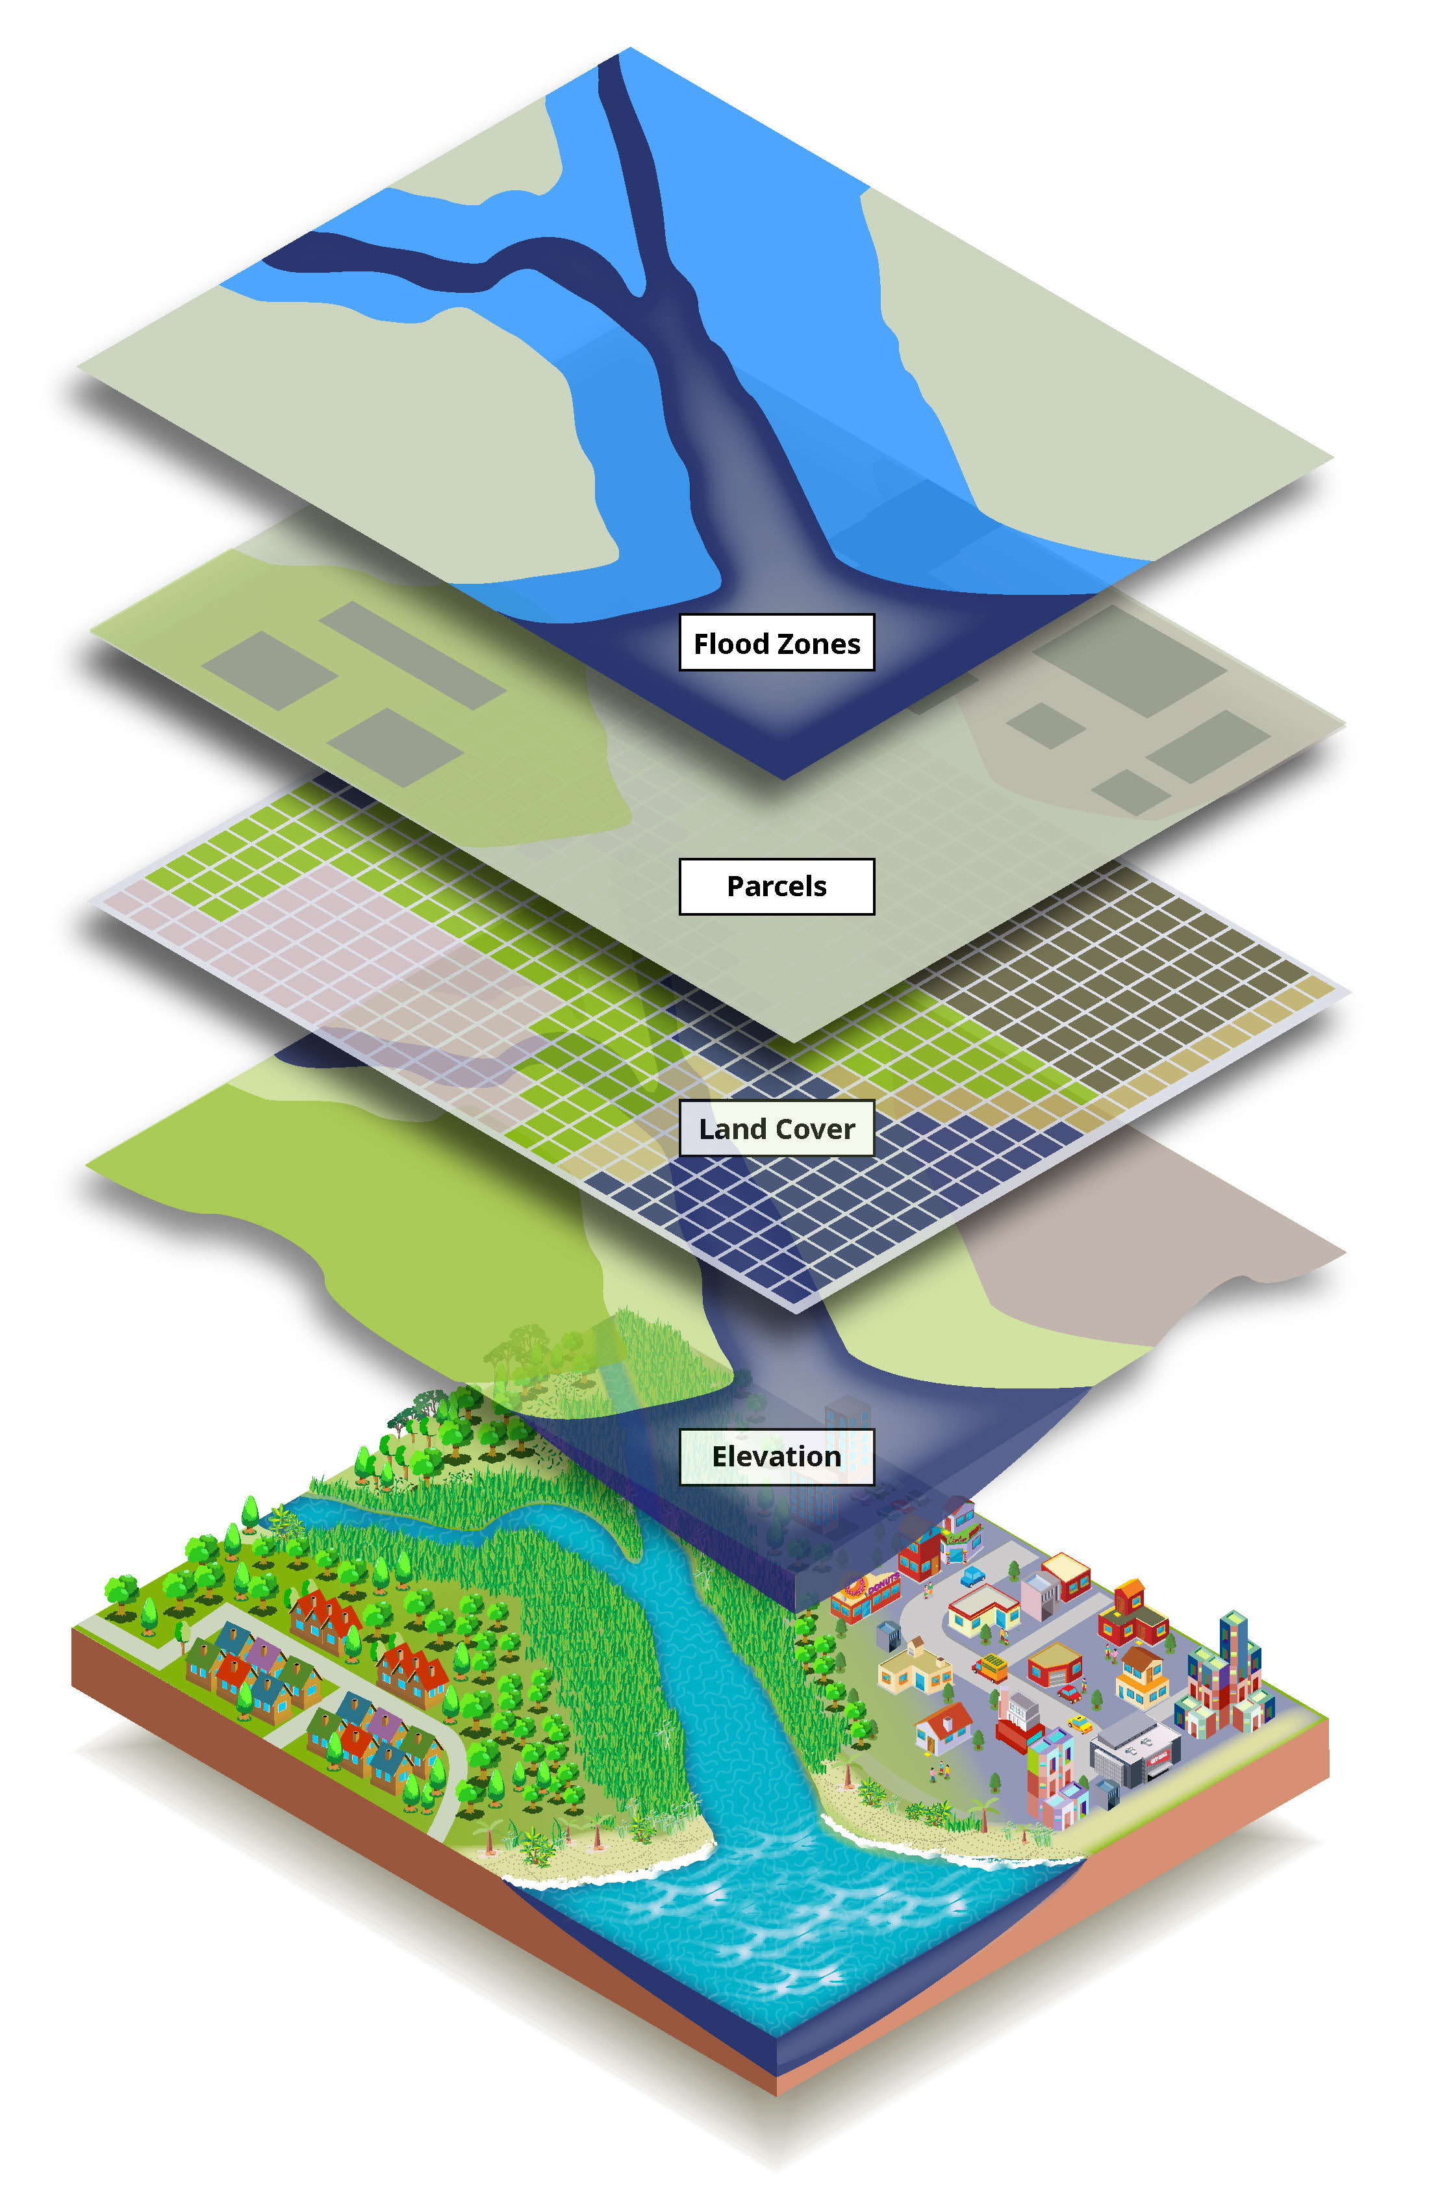
Intro to GIS
Today we live in a world with complex problems
  Growing Population
  Climate Change
  Social Conflicts
  Resource Shortages
  Loss Of Biodiversity
GIS can help us study problems and find solutions.

Slide 7
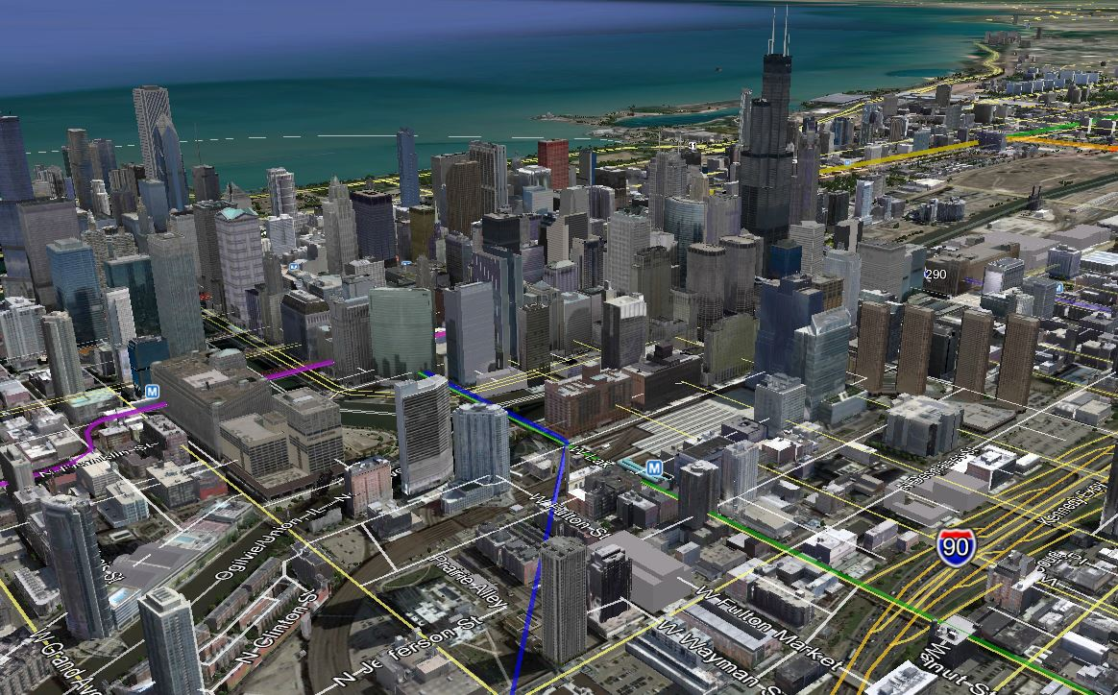
Intro to GIS
Map of Chicago in Google Earth shows:
  3D Buildings
  Transit Stations
  Highways
  Subways
  Waterways

Slide 8
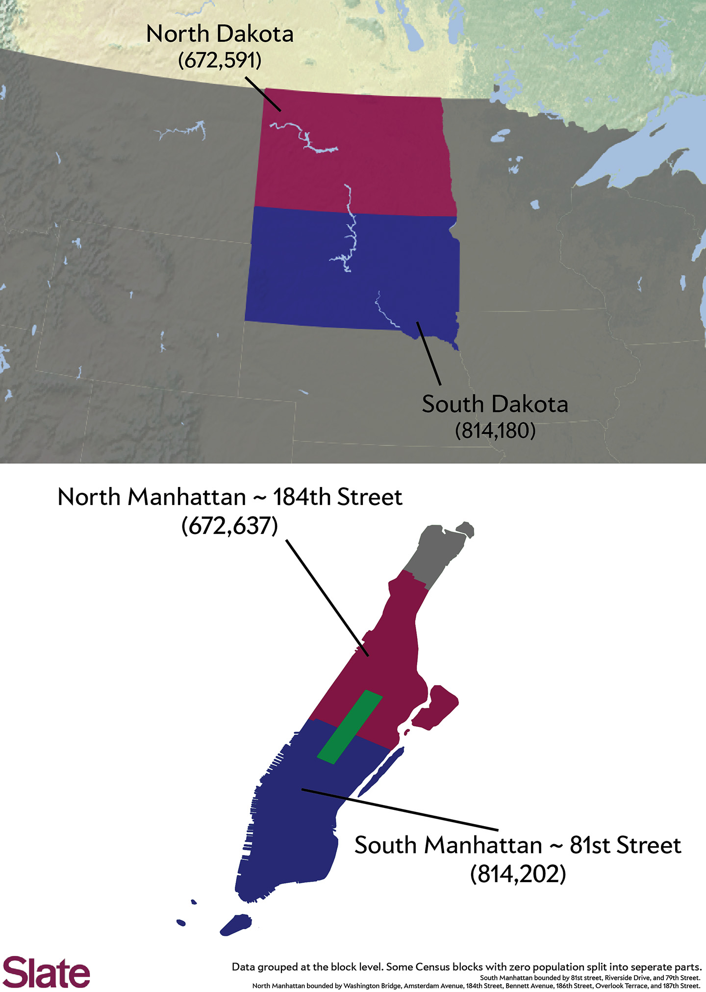
Using Maps to Show Populations
You can divide the island of Manhattan in two and the top half would be more populous than North Dakota, the bottom half more populous than South Dakota

Slide 9
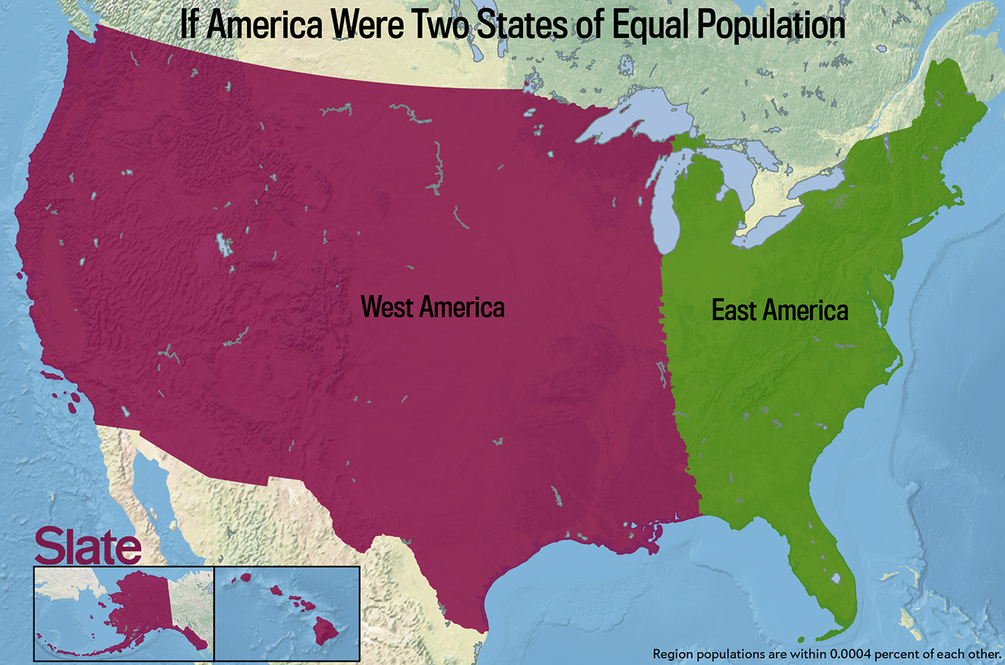
Using Maps to Show Populations
Splitting America into just 2 states of equal population.
Using the 2010 census as the data source, she drew this.
Each region has approximately 154,374,000

Slide 10
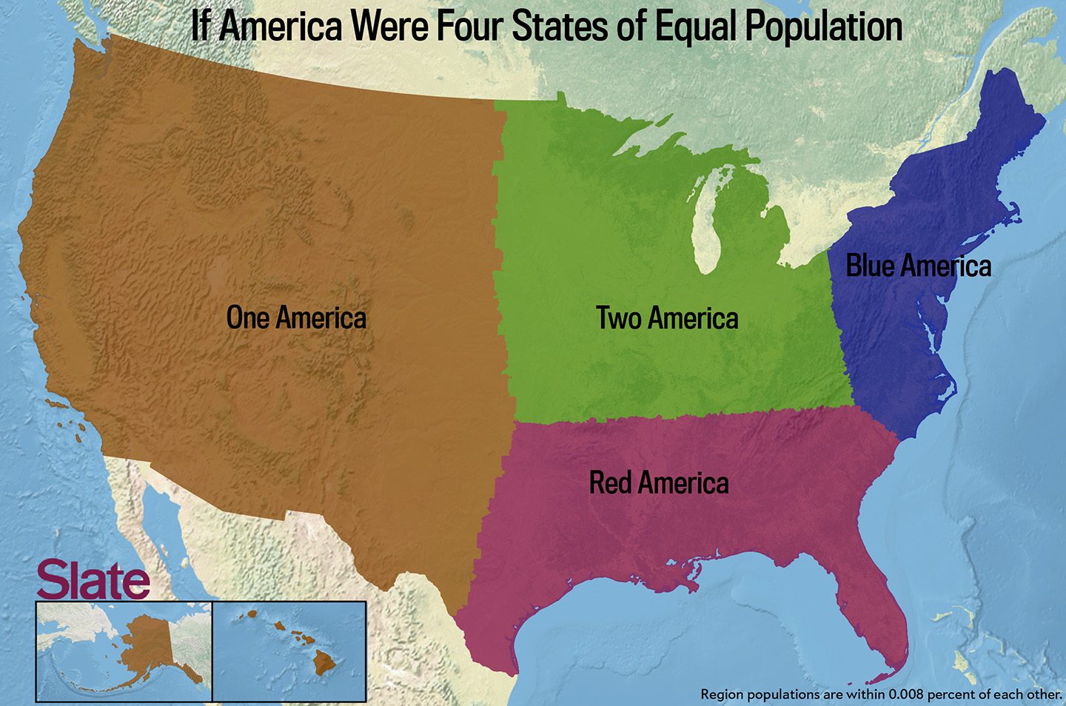
Using Maps to Show Populations

Slide 11
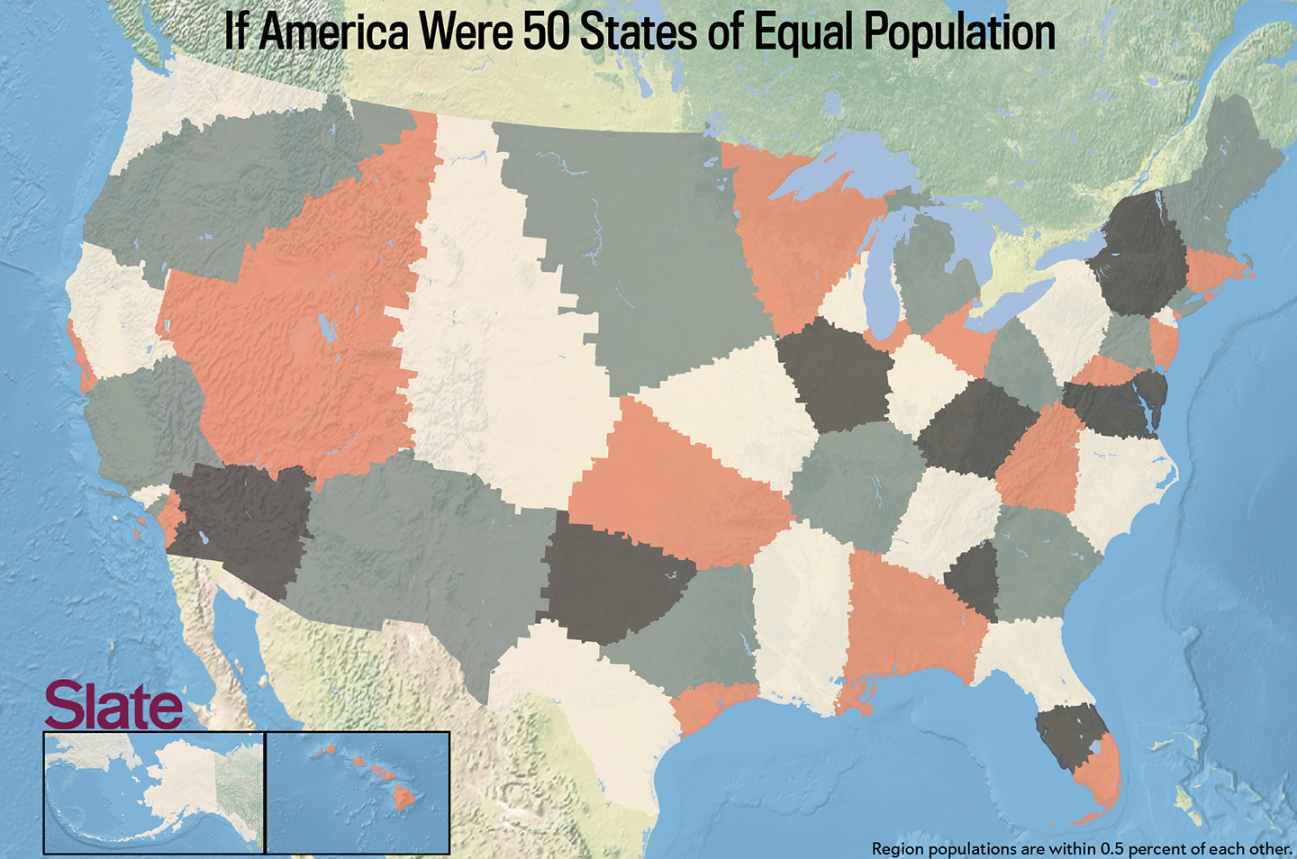
Using Maps to Show Populations

Slide 12
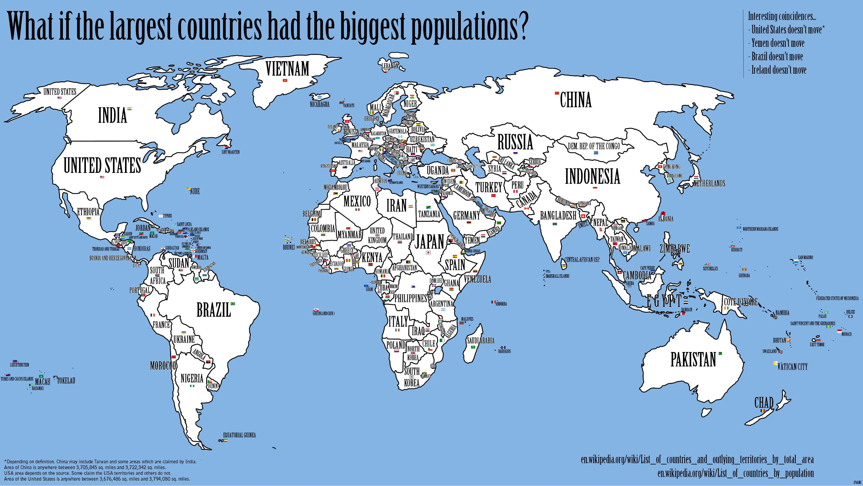
World's Countries Rearranged by Population

Slide 13
World's Countries Rearranged by Population
The 3 most populous nations:
  China
  India
  United States
The 3 largest countries
  China
  Canada
  United States

