Slide 1
Tips to Avoid PowerPoint Pitfalls

Slide 2
Take the time “make friends” with Slide Master functionality (warning: at first it can be frustrating!)
Create Master Slide layouts before adding any content if at all possible. It will make your life easier.
See the following slides tips and for common pitfalls using Slide Master
This is a useful beginning tutorial for Slide Master: (more links on last slide) https://www.gcflearnfree.org/powerpoint2016/slide-master-view/1/
Set slide size default first (slide 3)
Applying different layouts on existing slide content can be tricky; tutorials and other online help is often needed. (E.g. short you-tube: https://www.youtube.com/watch?v=h6ARCTypPTg)
For existing slides that were manually formatted, the manual formatting overrides “Slide Master formatting”. To reset slide formatting to match a Slide Master layout:
In Normal View, (not slide master) select slide thumbnail(s) from Slides Pane (left side)
Right-click for shortcut menu and pick Reset Slide
Or on Home tab/slides group, click Reset Slide
When possible, minimize manual* formatting, although some is always needed. Realize that updating a slide to a slide master layout, will “undo” existing manual formatting.
Especially for an image or text repeated on many slides (e.g. a logo), place on master slide, or use place holders in master slide, (slide master tab/ insert placeholder).
Caveat: for a presentation with only a few slides that are not identical, it may be quicker to do everything manually. Or alternatively, use only some formatting from slide master, e.g. slide number, footer, and logo, and do the rest of the formatting and details by hand. (See example, slide 3)
PPT = PowerPoint 365 in these slides (beware, there are slight differences between versions

Slide 3
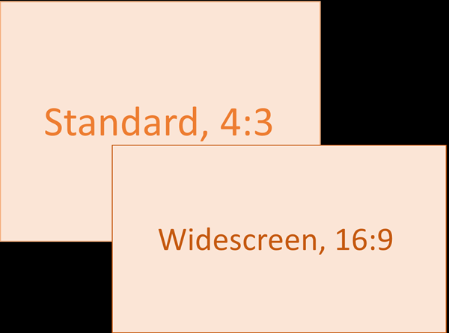
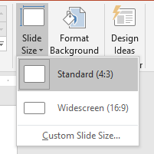
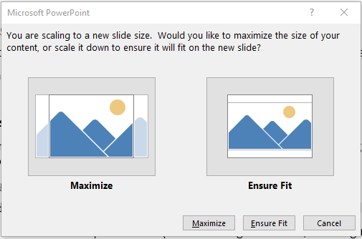
Set ‘Standard size’ as default screen size in PowerPoint
To set standard size as DEFAULT: https://www.indezine.com/products/powerpoint/learn/interface/2016/set-standard-ratio-default.html
Many screens are too narrow for PowerPoint’s widescreen setting.
1. To change from widescreen to standard size , click on "Design" tab
3. Select "Standard“ (4:3), and a window will pop up
2. Click drop down arrow by "Slide size"
4. To minimize re-editing in pop up window, select "Ensure Fit“

Slide 4
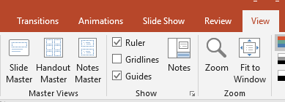
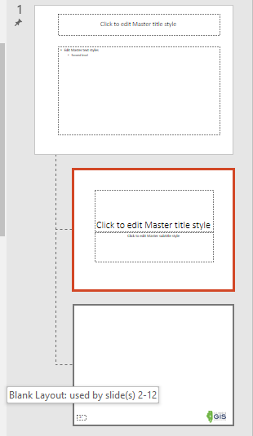
Common pitfalls with Slide Master formatting
Screenshot of this PPT in Slide Master View
Open slide master on View Tab, on ’Master Views’ group/Slide Master
Largest slide at very top of list, is The “Master Slide” (be sure to SCROLL TO VERY TOP slide)
The “Master Slide” controls ALL other slides. Any editing done on this slide affects ALL layouts
In Slide Master view, hover mouse over thumbnails for a pop on which slides have that layout. E.g. the first layout below The Master Slide is the default title slide layout. Editing the title slide layout (when in Slide Master), changes ONLY title slide when back in normal view.
A logo or object placed on Master Slide, will be “unclickable” in normal view; the only way to remove it is to delete it on the Master Slide. If logo only belongs on some slides – put it on another layout, not the Master.
E.g. bottom layout is used for all but the title slide – it has only the logo and slide number. All other content is inserted manually (in this case)
For more: https://support.office.com/en-gb/article/edit-and-re-apply-a-slide-layout-6f4338f8-555f-49cf-9835-6209be3c7b48?ui=en-US&rs=en-GB&ad=GB
When done editing layouts in Slide Master, close it
Slide Master Menu, click “Close Master View”
It is easy to forget you are in Slide Master mode - if you continue editing what you think is a single slide, you may edit an entire layout and unexpectedly change multiple slides.
E.g. if you have moved to say, Home tab, (while Slide Master is open) to change layout font size, you will have to return to View/Slide Master Menu (only shows when it is open) to Slide Master.

Slide 5
Save time with Themes or Templates in PPT and Slide Master
Use themes or templates when possible for formatting and content (What’s the difference?)
A theme is a predefined set of colors, fonts, effects, defined by a Slide Master; a template is a theme plus some content, e.g., a sales presentation, a classroom lesson, organization
Create your own, use powerpoint gallery, or download from online
See powerpoint templates specific to “GIS in Education” (free to use) on ILGISA website
Hints and pitfalls of themes and templates
Once design is complete, exit Slide Master view (Close Master View on Slide Master ribbon).
The first slide of template shows in preview. Save template after designing first slide.
File/ Save As. The Save As dialog will open. Change file type from PowerPoint Presentation (.ppt / .pptx) to PowerPoint Template (.pot / .potx)
File location to automatically change to a folder called Custom Office Templates, found in Documents Folder.
If you make your own template It is VERY important to save it in Custom Office Templates location to be able to open templates whenever other ppt sessions are opened
When you open a new PowerPoint you will see a list of templates. Above those templates are Featured and Personal.
Click on Personal and to select template you designed.
Also See: https://support.office.com/en-us/article/apply-a-template-to-your-presentation-d3d4ece5-e965-45eb-9423-c34e61b34616 and the links farther down the page

Slide 6
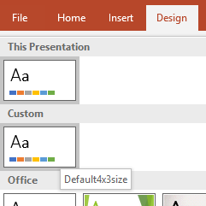
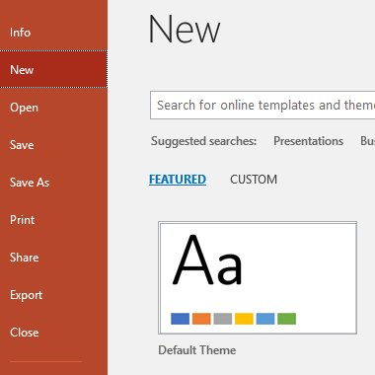
Customize themes and set as default to resuse easily
1. Create your own colors schemes and background colors or images.
2. Click drop down arrow on ‘Themes’ and select “Save Current Theme….”
3. Rename the theme, e.g. Default4x3size.thmx (do NOT change save location!)
4. Back on Design tab, click dropdown arrow again, and look under “Custom”.
Hover mouse over theme to see the name
5. Right click default theme you created, select “Set as Default Theme”
6. Close then re-open a new PowerPoint.
“Default” theme is what you just created.

Slide 7
Lists (and potential pitfalls) in PPT
Use default lists of numbers or bullets
To customize lists, change indent or bullet type (for example), set up your own style in the Slide Master.
See slides 8-10
https://support.office.com/en-us/article/video-change-list-formatting-on-the-slide-master-d5841b2a-2dd0-46f3-b288-41d2ebe3d077
or
https://guides.lib.umich.edu/c.php?g=283149&p=1886372

Slide 8
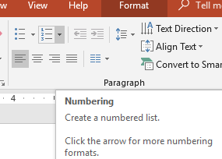
Lists in PowerPoint 2016, con’t
This is your list
Change slide size
Select "Standard", and a window will pop up
Select ensure fit
Click ok
You want to make the first line be #1,
and lines 2-4 to be a., b., and c.
Select the first line in the text box
Then click the number list button
(Edit bullets in the same way as numbered lists – just using symbols instead of numbers).
This is the result:

Slide 9
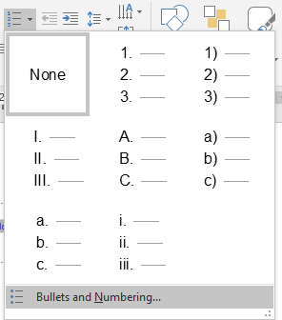
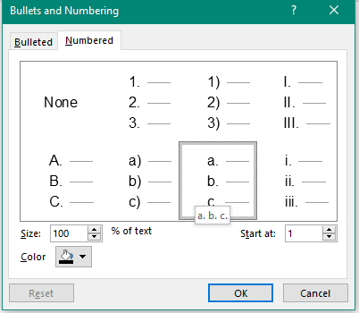
Lists in PowerPoint 2016, cont.
To make more than one level of a list, that is to label lines 2-4 as a, b, and c, select them
With lines 2-4 highlighted, click dropdown next to number list button and select “Bullets and Numbering”
In pop up window, click box with a. b. c. then click okay
This is the result:
Change slide size
Select "Standard", and a window will pop up
Select ensure fit
Click ok

Slide 10
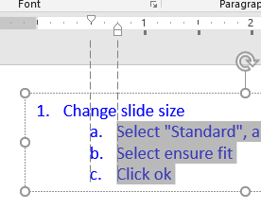
Lists in PowerPoint 2016, cont.
To change indentation of the lettered lines, select only those lines (not the top line)
Click the “Indent” button
Use these buttons to indent or outdent. They work better than using “Tab” key on keyboard. They are grayed-out until something is selected
This is the result:
Change slide size
Select "Standard", and a window will pop up
Select ensure fit
Click ok
To manually change indent, select lines to edit, and “indent markers” will show - click and drag little white symbols
adjusts the first-line indent)
adjusts the hanging indent
moves both the first-line indent and hanging indent markers at the same time (this will indent all lines in a paragraph)

Slide 11
PowerPoint formatting
Potentially useful links (as of July, 2018)
(No endorsement intended)
https://www.gcflearnfree.org/powerpoint2016/slide-master-view/1/ (Tutorial on Slide Master)
https://www.slideteam.net/free-business-powerpoint-templates/
https://www.slideshare.net/explore
https://www.indezine.com/products/powerpoint/learn/interface/2016/set-standard-ratio-default.html
http://myfreeppt.com/free-powerpoint-templates/education/
https://www.youtube.com/watch?v=h6ARCTypPTg
https://stackoverflow.com/questions/tagged/powerpoint
https://stackexchange.com/
https://support.office.com/en-us/article/video-change-list-formatting-on-the-slide-master-d5841b2a-2dd0-46f3-b288-41d2ebe3d077
https://guides.lib.umich.edu/c.php?g=283149&p=1886372
If none of the links help, Google: best way to use Master slide in PowerPoint versionXXX
Help on a huge range of topics, not just ppt.
GIS in education
https://www.slideshare.net/NearcPresentations/nearc-slides-cbtimjcad
https://education.usgs.gov/undergraduate.html#geography
https://www.slideshare.net/aGISGuy/what-is-gis-1655272
https://www.esri.com/en-us/industries/education/schools/instructional-resources

